Slide 1
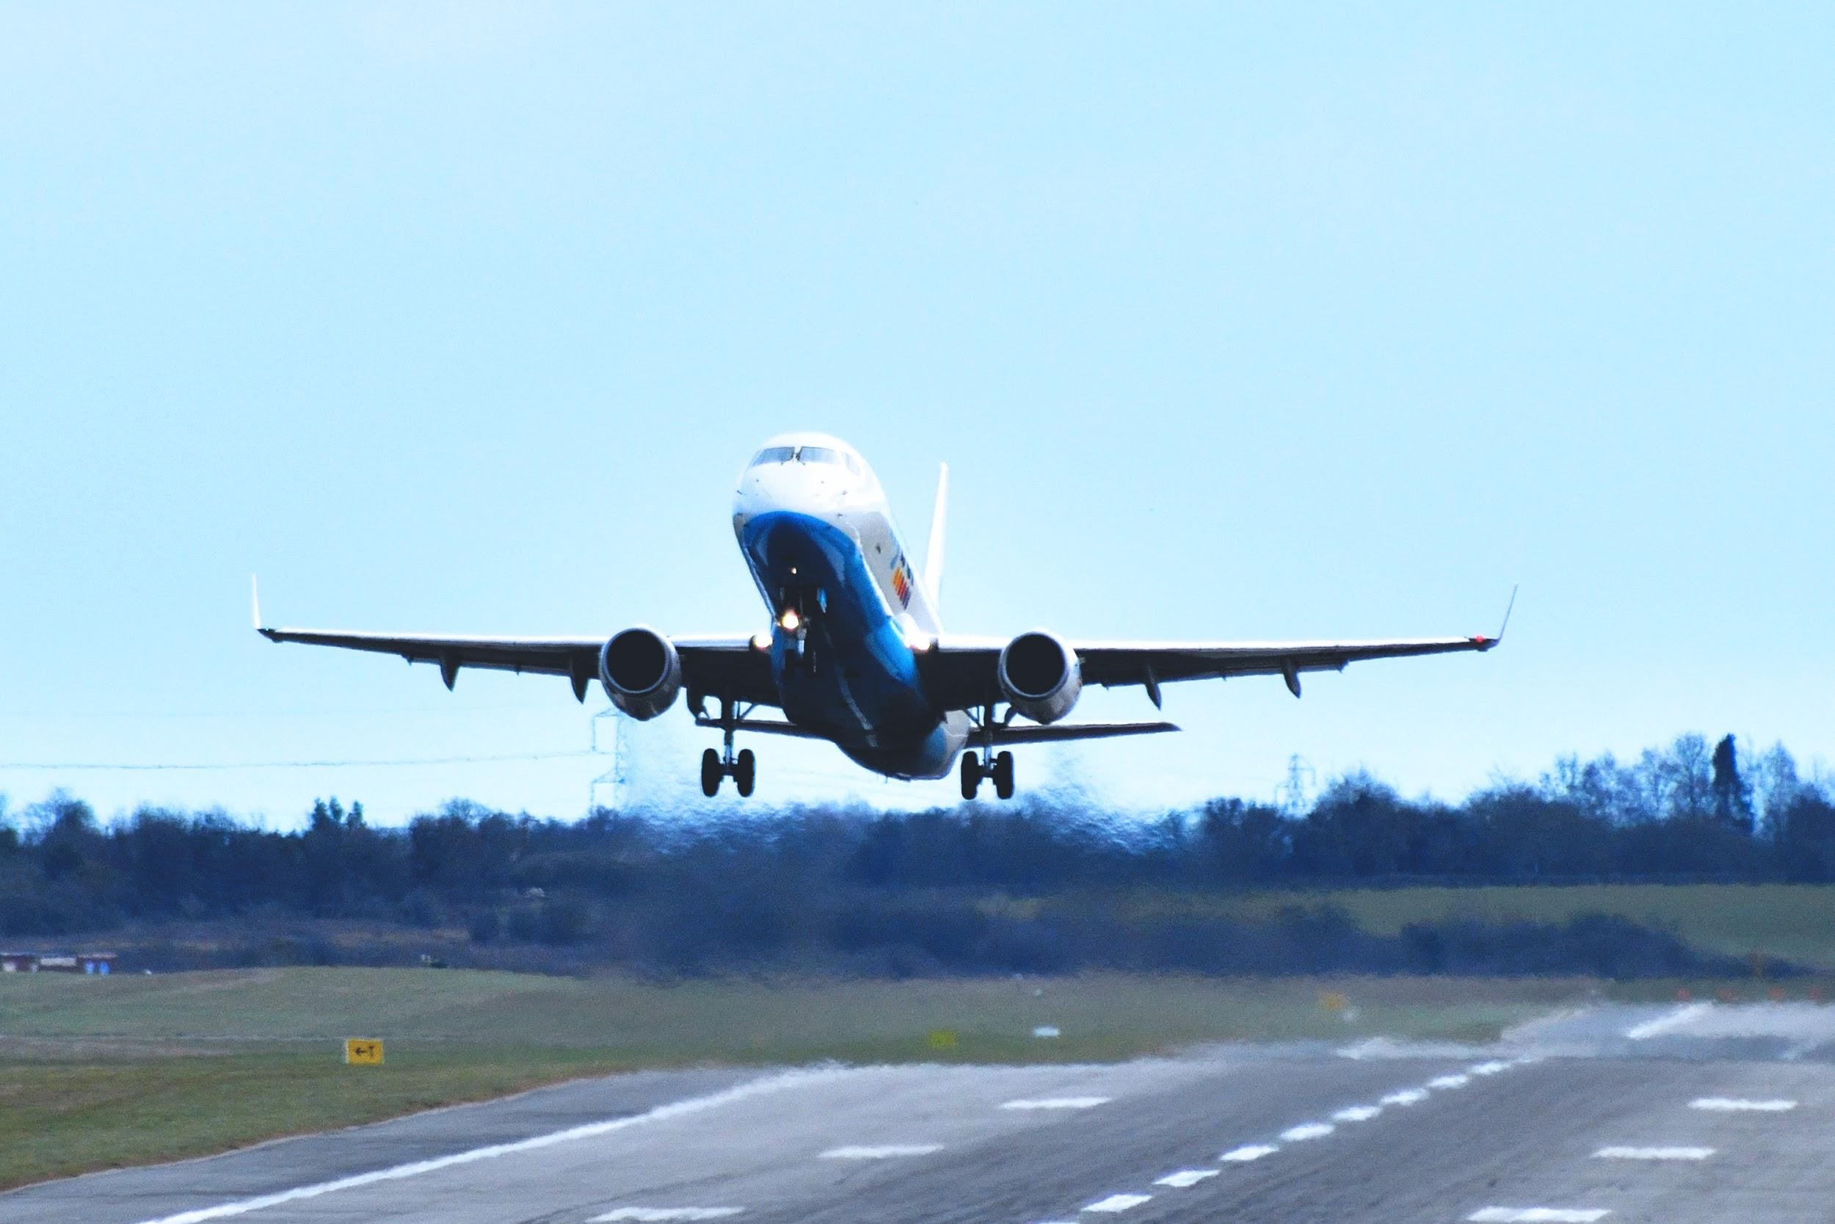
FLIGHT DELAY PREDICTION
STAT 652 - Project
ARCHANA SUBRAMANIAN
301402868

Slide 2
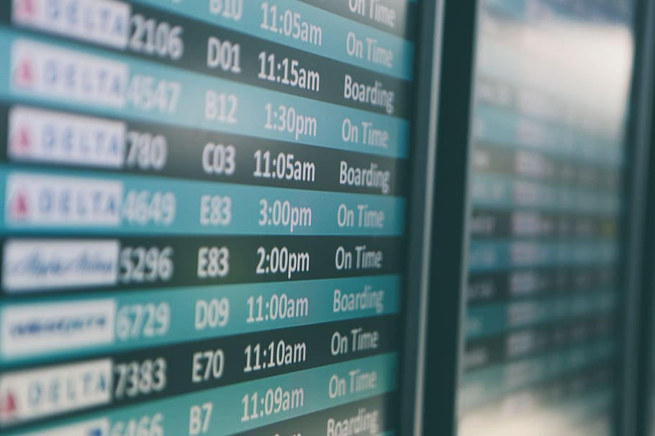
Why this data?
Flight schedules are almost always erratic.
A little personal inspiration.
Source:
https://www.kaggle.com/divyansh22/flight-delay-prediction?select=Jan_2020_ontime.csv

Slide 3


What is the data about?
The data is basically flight schedule information in the US for the month of January.
21 features both continuous and categorical.
Huge dataset with ~600k rows. It was very difficult to explore with the entire dataset, so I took a random 10k records to do my evaluation.
The target variable is categorical with 2 levels - 1 -> delay
- 0 -> no delay

Slide 4
Analysis Outline:
Due to the huge dataset, I made a choice of exploring only a part of it
(10k records) to give sufficient time to explore models.
Removed correlated variables.
Randomly split the data into train and test sets.
Used the data to fit models (scale data if necessary).
Observe the error and chose the model with the least error as the best model.

Slide 5
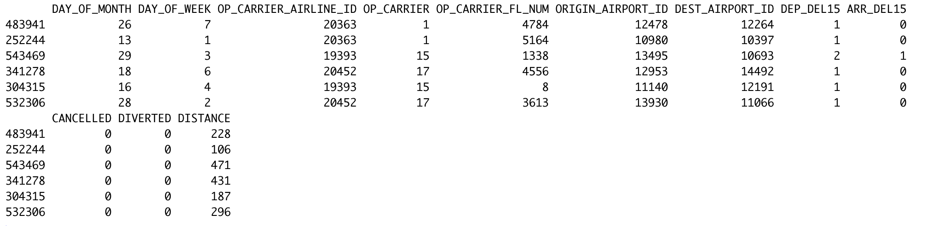
Sample data:
Here is a sample of the data that was used for modelling after removing the correlated columns and converting the categorical columns to factors.

Slide 6
Relevant Steps:
Picked a random (~2%) subset of the dataset and used this for all analysis.
Removed correlated columns.
Converted all categorical variables to factors.
Re-scaled other columns between 0 and 1.
Fit multiple classification models using the above modified data.
Inferred the error (misclassification rate) for each model.
Least error = Best model
Winner - Neural Network

Slide 7

Observations:
Models | Misclassification rates
KNN (k = 8) | 0.1448
Logistic regression | 0.0728
Lasso Min | 0.8592
Lasso 1SE | 0.1408
RF Default | 0.0744
SVM | 0.1464
NN | 0.0672

Slide 8
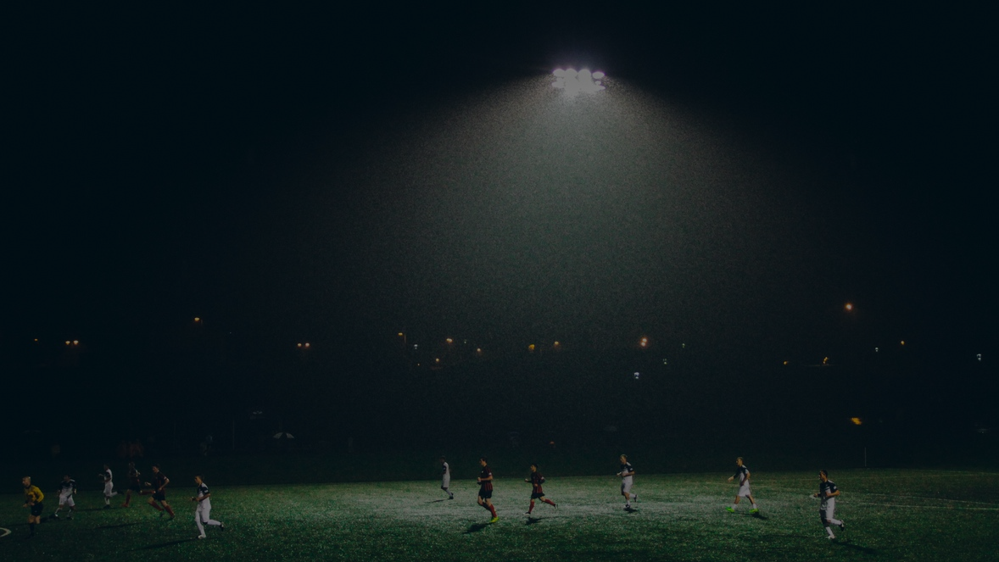
Measure of uncertainty:
Based on the least errors observed for all models, I concluded neural nets as the best, as it had least misclassification rate.
Confusion matrix:
 | Predicted
Observed | 0 | 1
0 | 2053 | 85
1 | 98 | 264

Slide 9

Challenges:
Size of the data.
Categorical explanatories.
Multiple correlated features.

Slide 10
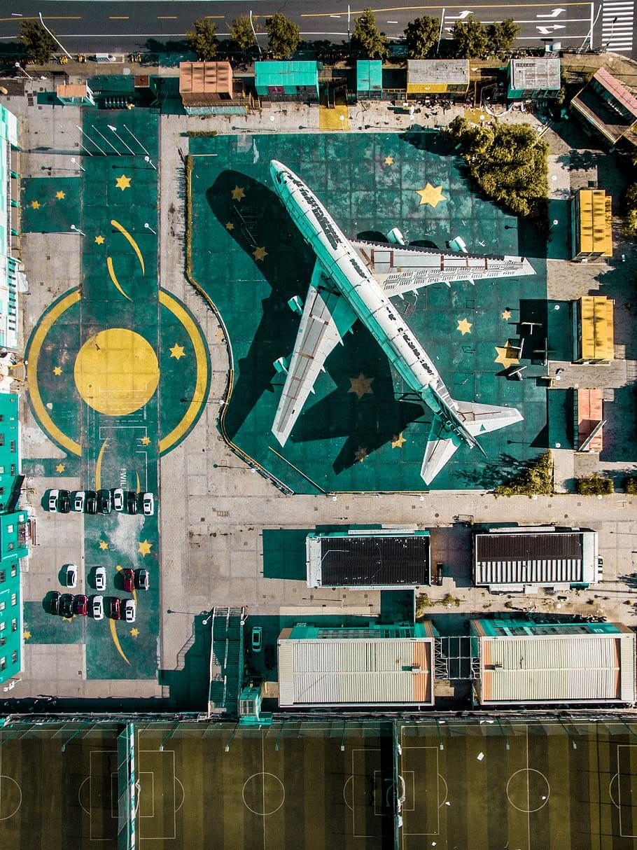
Conclusion:
With the knowledge gained from Lectures 17-22 on Classification form of supervised learning and its corresponding models, I was able to develop and apply suitable models for the data I chose.
With the performance that I observed, I believe that the data predicted would be more than 90% accurate if done using Neural nets.

Slide 11
Thank you!

